Slide 1
3D Rasterization:
A Bridge between Rasterization and Ray Casting
Tomáš Davidovič
T. Engelhardt, I. Georgiev,
P. Slusallek, C. Dachsbacher
Saarland University, Intel VCI & Karlsruhe Institute of Technology

Slide 2
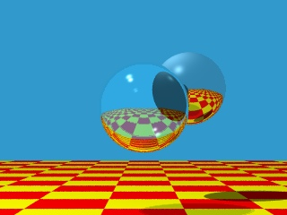
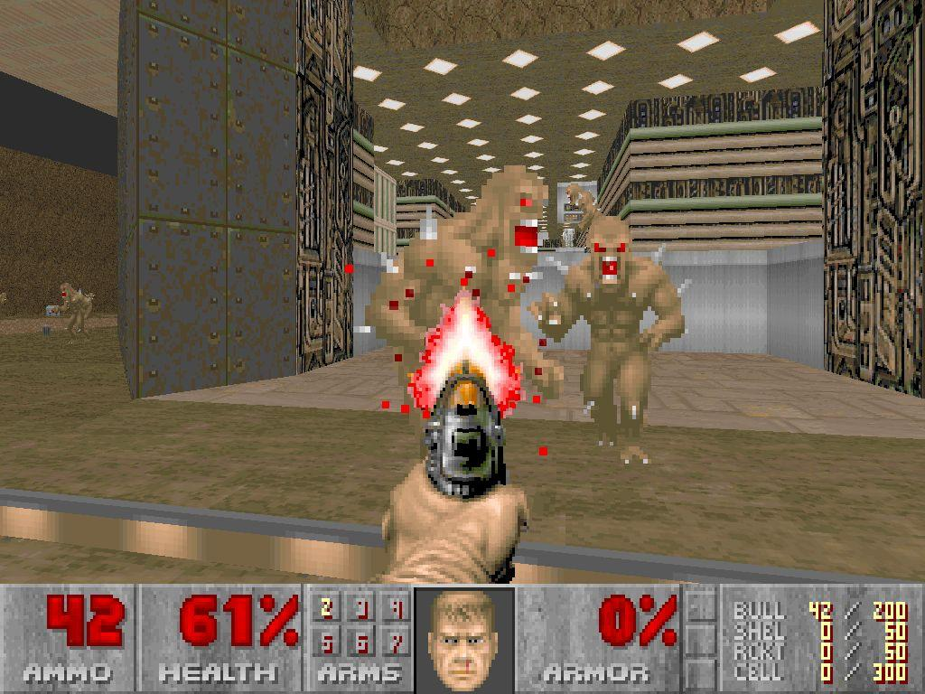
Ray Tracing vs Rasterization
Whitted ray tracing
  1979...
  OptiX 2010
Doom
  1992
Notes:
I will start with a short look into the history. The thing that many people connect with ray tracing is this. Chrome and glass spheres over a checkerboard.
This is generally known as whitted style ray tracing, and comes from 1979.. Even though the image here is actually from Optix, some time in 2010.
Fast forward 13 years, we have a game that just about all of us played, Doom. Now, looking at the images, one is ray tracing, the other is rasterization, clear, simple.

Slide 3
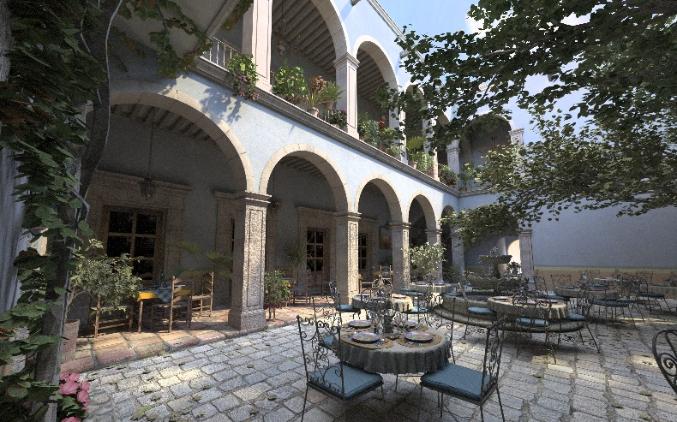
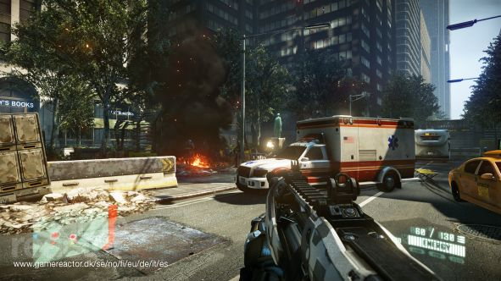
Ray Tracing vs Rasterization
PBRT – San Miguel
  ~2010
Crysis 2 by CryTek
  ~2010
Notes:
Now lets have a look at the present. I am showing you again two images, again one is ray traced and the other is rasterized, but you are now much more pressed to tell which is which. Obviously quality of both went up a lot, but also the overall bag of tricks used in each method makes them converge towards same level of image quality. But even so, the difference is still here and we often hear questions like “is that ray traced? Is that rasterized?”.
What I would like to do in this talk is to show, that this distinction can and should be relaxed, and that we can do interesting stuff once we realise that.

Slide 4
The main goal
Notes:
The main goal of both methods is the same. We have a screen with pixels. And we have some geometry. And for each individual pixel, we want to find the closest geometry seen through this pixel.

Slide 5
The main goal
Edge functions
p1
< 0
> 0
p0
p2
Notes:
Now let’s talk about edge functions. We have our triangle, with vertices p0, 1, 2. Each pair of vertices defines an edge. This edge splits the plane in which triangle lies into two half planes, one contains the third vertex and one does not. This is indicated by sign of the edge function. We do this for all three edges and point that lies in all three positive half planes lies within the triangle.

Slide 6
The main goal
2D rasterization
p1
p0
p2
Notes:
So how is that useful. The standard rasterization projects the triangle to screen, defines edge functions there. Then it scans screen with a window, or bin. If all four corners are clearly outside the triangle, it moves on to the next one. If that is not the case, it refines to the next level, ultimately ending at individual pixels and tests coverage there. Then the depth of a sample is computed, compared to the depth buffer and either accepted or discarded.

Slide 7
The main goal
Ray casting
Notes:
With this in mind, let’s now have a look at ray tracing. The goal is the same, but the mechanism is bit different. We have a pixel, and through it we shoot a ray.

Slide 8
The main goal
Ray casting
p1
d
p0
n
e
p2
n = (p2 – e) × (p0 – e)
V(d) = n . d
Notes:
Ok, so let’s have a look at a pretty standard Pluecker intersection test. We have a ray with origin E, direction D, and a triangle with three vertices. We define a triangle E, p0, p1. We compute cross product of two of its edges, giving as a non-normalised normal. We take dot product of this normal with ray direction, and the result is actually a signed volume of a tetrahedra E, p0, p2, and E+d. The blue triangle actually splits space into two half spaces, and then the volume is positive when D is in the same half space as p1. And that’s pretty much exactly the same thing as with 2D rasterization, except we are in 3D.
So we will have these volumes for each of the triangle edges, and pixel is covered by the triangle when all volumes are positive.

Slide 9
3D Rasterization
Frustum tracing
Notes:
So, we now have 3D edge functions, that work pretty much the same way as 2D rasterization functions.
To be able to draw on similarities with rasterization, we have to work on more or less coherent grid of pixels, which translates to the well know frustum tracing.
Overall, frusta are associated with primary rays, but as shown by Benthin in 2009, they are also very useful for soft shadows.
So just to reiterate what is a frustum for us. We have a whole bunch of rays with a common origin, that are aimed in somewhat similar direction, and we can define corner rays as shown in the picture.

Slide 10
3D Rasterization
Pseudocode
Traverse( frustum F, node N ) {
Notes:
Lemme now bother you with pseudocode for the algorithm we use to show similarities between frustum tracing and standard rasterization.
We will start with a frustum of rays, and a node containing part of the scene. The node can come from BVH, can be from scene graph, or can be just a box that contains all triangles in the scene with no hierarchy whatsoever. It is important to note, that while a good hierarchy is not at all required, it indeed does help to have one.

Slide 11
3D Rasterization
Frustum tracing
Notes:
This is what a frustum looks like, when viewed from the side.

Slide 12
3D Rasterization
Pseudocode
Traverse( frustum F, node N ) {
if ( isOutside or isOccluded ) return;
Notes:
First thing we test is whether node is outside or completely occluded.

Slide 13
3D Rasterization
Frustum tracing
isOutside
isOccluded
Notes:
Outside means the frustum completely misses the node. This is the same as view frustum culling in the standard rasterization.
Occluded is equivalent to hierarchical depth buffer. Each ray knows the closest hit distance, same as each pixel knows its closest fragment, and we can cull objects that are farther than the maximum among such distances. Same as 2D rasterization, we use a hierarchy over rays to make the lookup fast.

Slide 14
3D Rasterization
Pseudocode
Traverse( frustum F, node N ) {
if ( isOutside or isOccluded ) return;
if ( splitFrustum ) {
split F into sub-frusta Fi
foreach ( Fi ) traverse ( Fi, N )
}
Notes:
We can also decide that the frustum is too large for use and we want to split it, similar to when rasterization window/bin is divided.

Slide 15
3D Rasterization
Frustum tracing
Splitting
Notes:
The one simple heuristic we use to determine when to split is the middle ray. If the ray that goes through the center of the frustum misses our node, we split.

Slide 16
3D Rasterization
Frustum tracing
F1
F2
F3
F4
Notes:
We do simple quad tree split.
The other options would be to refine when the cross section of the frustum becomes significantly larger than the node.

Slide 17
3D Rasterization
Pseudocode
Traverse( frustum F, node N ) {
if ( isOutside or isOccluded ) return;
if ( splitFrustum ) {
split F into sub-frusta Fi
foreach ( Fi ) traverse ( Fi, N )
} else {
if ( generateSamples ) {
rasterize ( N, binning )
} else {
foreach ( child of N )
traverse ( F, child of N )
} }
Notes:
When we are not splitting, we can either directly generate samples (intersect rays with triangles within the node) or descend into the child nodes.

Slide 18
3D Rasterization
Binning – vertex culling
p1
p0
p2
Notes:
When we get down to the triangles, we perform frustum triangle intersection similar to Vertex Culling introduced by Reshetov 2007.
What rays are left in the frustum when we start intersecting can still be used for binning, where can eliminate whole subfrusta with tests using only corner rays.

Slide 19
3D Rasterization
Psuedocode
Traverse( frustum F, node N ) {
if ( isOutside or isOccluded ) return;
if ( splitFrustum ) {
split F into sub-frusta Fi
foreach ( Fi ) traverse ( Fi, N )
} else {
if ( generateSamples ) {
rasterize ( N, binning )
} else {
foreach ( child of N )
traverse ( F, child of N )
} }
Notes:
So this is what the whole thing looks like when put together, and the only reason why I show it is this:

Slide 20
3D Rasterization
As rasterization
Traverse( frustum F, node N = All Scene ) {
if ( isOutside or isOccluded ) return;
if ( splitFrustum ) {
split F into sub-frusta Fi
foreach ( Fi ) traverse ( Fi, N )
} else {
if ( generateSamples ) {
rasterize ( N, binning )
} else {
foreach ( child of N )
traverse ( F, child of N )
} }
Notes:
When we have node containing triangle soup of the whole scene, don’t do any splitting and any traversal, we have our standard rasterization with view frustum culling.

Slide 21
3D Rasterization
As ray casting
Traverse( frustum F = Single ray, node N ) {
if ( isOutside or isOccluded ) return;
if ( splitFrustum ) {
split F into sub-frusta Fi
foreach ( Fi ) traverse ( Fi, N )
} else {
if ( generateSamples ) {
rasterize ( N, binning )
} else {
foreach ( child of N )
traverse ( F, child of N )
} }
Notes:
When we use it like this, having frusta of a single ray, no splitting and no binning, we have our single ray tracer.

Slide 22
Results
What can we do
Non-planar viewports
Notes:
Let’s now get to the results. We don’t really have one stunning picture to show you as result, as our result is more in the new insights and idea transfer field.
First thing that we tried to use this for are non-planar viewports.

Slide 23
Results
Non-planar viewports
p1
p2
p0
Notes:
When we look at a triangle using parabolic viewport, we can see that the edges are nowhere near straight lines.
In fact, each of them is a section of circle.

Slide 24
Results
Non-planar viewports
Notes:
Trying frustum binning on these rounded edges would obviously lead to many false negatives.
What we do is, we determine the amount by which we have to extend the bin (shown as red line here)

Slide 25
Results
Non-planar viewports
Notes:
And use these shifted corners to do the binning. Now if the radius is smaller than size of a bin, we cannot really determine anything and have to subdivide. This caused an overhead of roughly 18% in our tests using randomly generated triangles.

Slide 26
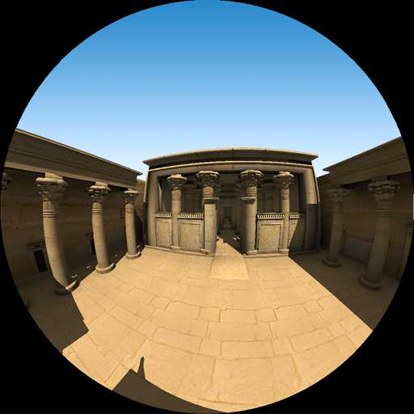
Results
Non-planar viewports
Notes:
And here are some pictures we were able to render using this technique, with parabolic…

Slide 27
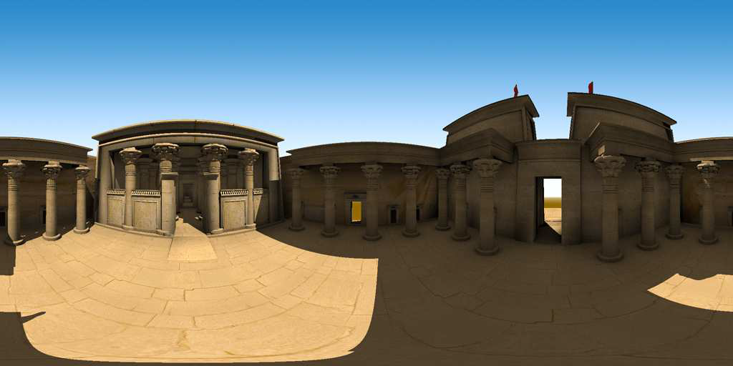
Results
Non-planar viewports
Notes:
And lat-long mapping.

Slide 28
Results
What can we do
Non-planar Viewports
Consistency
Notes:
The second thing we did were consistency rules.

Slide 29
Results
Consistency
p1
dy
d
p0
dx
n
e
p2
n = (p2 – e) × (p0 – e)
V(d) = n . d
Vx= deriv(V(d), x) = n × dx
Notes:
And for this I will need to show one more slide with ugly math.
Given derivatives of ray direction (dx, dy), we want to get derivative of tetrahedron volume when ray moves in x and y.

Slide 30
Results
Consistency
Notes:
Why is that important? We use the same rules for consistency that OpenGL does

Slide 31
Results
Consistency
Vx > 0
dy
dx
Notes:
Lets have a look at this triangle, this pixel. It straddles the edge exactly, and we have to make a consistent decision which triangle it will belong to.
If it falls between cracks and belongs to no triangle, that is obviously bad as we would have a hole.
On the other hand, when both triangles claim it we can have z-fighting, or if they are both transparent then we can have darkening along the edge.
We look at the derivative of ray direction, and of the volume associated with given edge, and assign it to the triangle that has positive volume derivative along x. Intuitively, to the triangle that is to the right.

Slide 32
Results
Consistency
dy
Vx = 0
Vy > 0
dx
Notes:
If the edge is horizontal and derivative along x is 0, we look at the derivative along y, and assign to triangle that is above.

Slide 33
Results
Consistency
Vx > 0
Vx > 0
dy
dx
Notes:
For if the pixel is not on just one edge, but actually hits the triangle vertex directly, we assign to triangle that has both edge derivatives > x;
And again, we assign to the right, and have special conditions if the edges are Vx = 0 and so on.

Slide 34
Results
What we can do
Non-planar Viewports
Consistency
Coverage Sampling Antialiasing
Notes:
Another idea transfer we did was coverage sampling antialiasing.

Slide 35
Results
Coverage Sampling Antialiasing
Notes:
When we have really small triangle, our samples, or rays might miss it.

Slide 36
Results
Coverage Sampling Antialiasing
Notes:
The standard solution would be to throw more primary rays at it.

Slide 37
Results
Coverage Sampling Antialiasing
Notes:
However, we can borrow from rasterization here. We have these red dots, that represent our primary rays. But that gives us little idea about whether and how much of the triangle is actually covered by the pixel. What coverage sampling does, it creates new rays that are used only for determining covered area of the triangle. As such, they are extremely cheap and light weight.

Slide 38
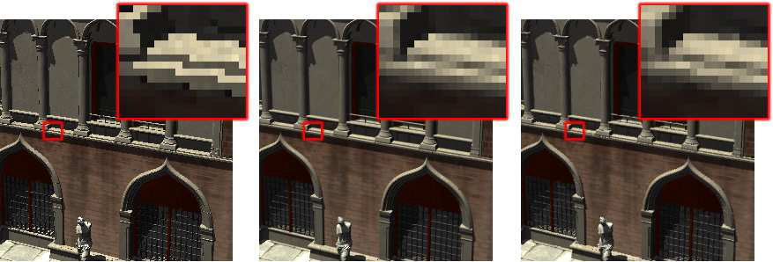
Results
Coverage Sampling Antialiasing
No AA
16x OSAA
Time x11
CSAA (4+12)
Time x4.3
Notes:
But as you can see, the results are surprisingly good. On left we have image with no anti-aliasing whatsoever. In the middle, we have 16x oversampling AA, where we simply throw 16 rays at each pixel. This resulted in 11x slower rendering than no AA. On the right we have our implementation of coverage sampling. We have 4 “full” per pixel (red dots) and then use additional 12 samples to determine coverage. As you can see, the result is almost the same as oversampling, but the whole rendering is only 4x slower than no AA, instead of 11x.

Slide 39
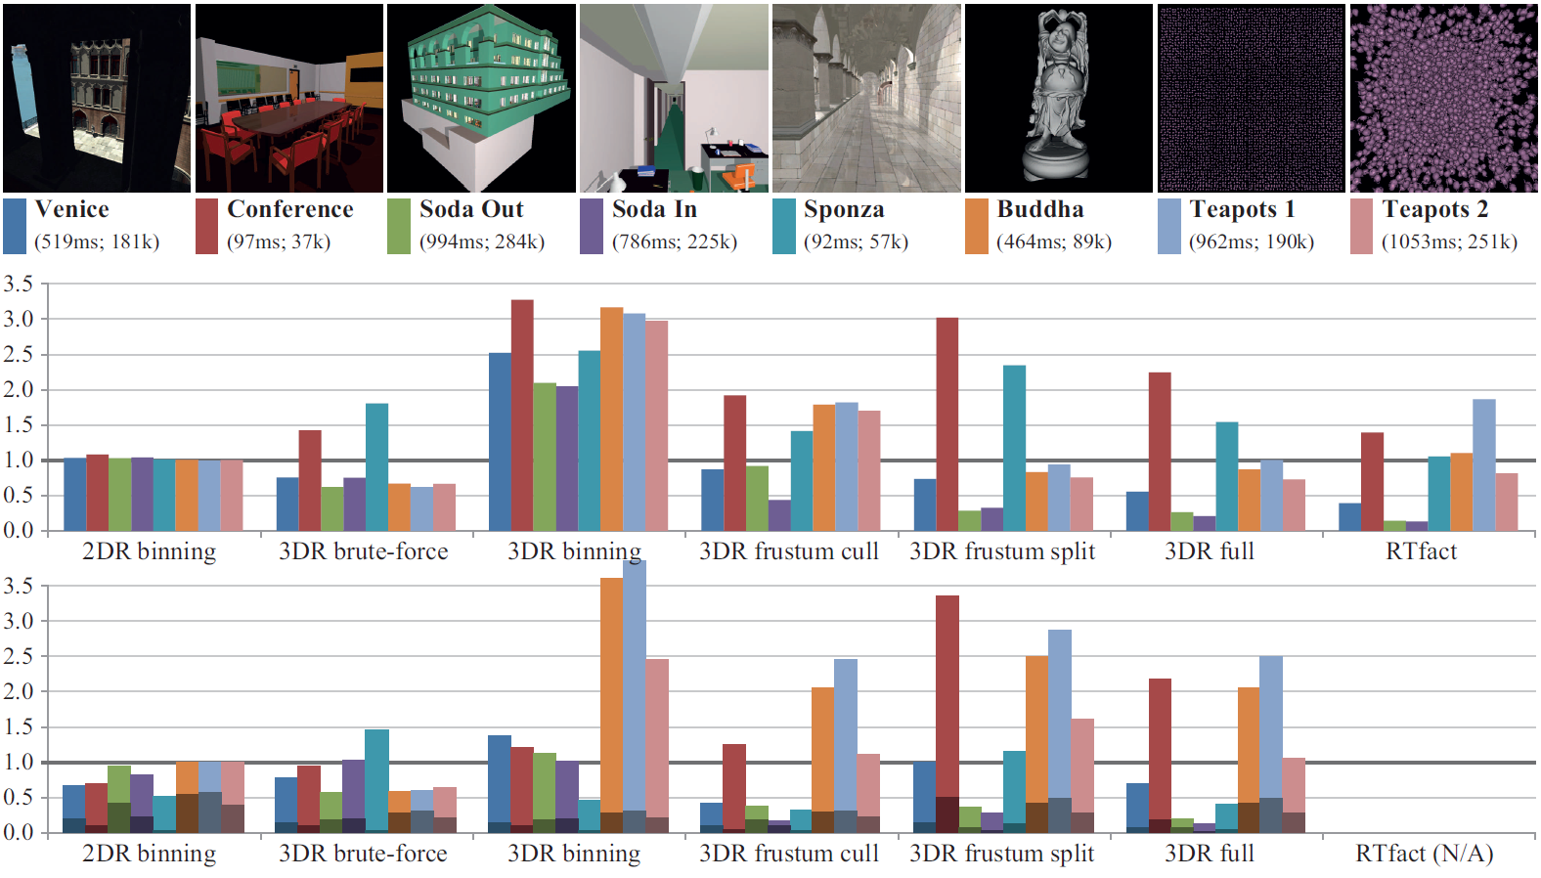
Results
Raw performance
Notes:
This slide just illustrates the raw rendering performance of our implementation with various options on and off. The lower is better. As we add more features like frustum culling, and splitting the rendering times get better.
The bottom graph shows instruction count spent on rendering the frame, and again, the lower the better

Slide 40
Conclusions
What to bring home
3D Rasterization
  Poses ray tracing as rasterization
Transfer of old ideas
  CSAA, binning
New ideas
  Frustum splitting, Non-planar viewports
Future work
  More general frusta
  Unified software rasterization pipeline
Notes:
To conclude, we present 3D Rasterization, which poses ray tracing in the rasterization context of edge functions.
This allows us to transfer some old ideas from rasterization like coverage sampling AA, and binning;
As well as encourages new ideas, like frustum splitting and non planar viewports.
In the future work, we would like to focus on more general frusta, where the main challenge is how to split frusta that don’t live in a fixed grid.
In more distant future, we would like this to become part of unified software rasterization pipeline (LRB, CUDA)

Slide 41
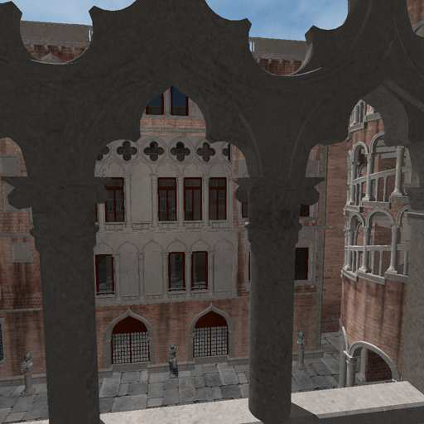
Tomáš Davidovič
Notes:
And thank you for your attention

